Slide 1
April 10, 2014
MATH 323
Graph Theory
Cr. 3
Lecture 3
Prof. Dr. Bhadra Man Tuladhar

Slide 2
Special Graphs
A graph G is bipartite, if its vertex set can be partitioned into two set X and Y in such away that every edge of G has one end vertex and another in Y. In this case, X and Y are called partite sets.
X
Y
X
Y

Slide 3
Special Graphs
A bipartite graph with partite sets X and Y is called a complete bipartite graph , if its edge set is of the form E = {xy, x∈X, y∈Y}. Such a graph is denoted by K_{m,n}, where |X|=m and |Y|=n.
The complete bipartite graph K_{m,n} consists of (m+n) vertices and m×n edges.
K_{2,3}
K_{3,3}
K_{1,5} (star Graph)

Slide 4
Theorem
A graph is bipartite if and only if it has no odd cycles.
Proof: Necessity (⇒).
Let G be (X,Y)-bipartite. For a cycle C: v₁ → ... → v_{k+1} = v₁ of length k, v₁∈X implies v₂∈Y, v₃∈X, ... , v_{2m}∈Y, v_{2m+1}∈X. Consequently, k+1 = 2m+1 is odd, and k = |C| is even.

Slide 5
Proof (Contd.)
Sufficiency (⇐).
Suppose G has no odd cycles. We prove that G is bipartite by constructing a bipartition of each nontrivial component. Let u be a vertex in a nontrivial component H of G. For each v∈V(H), we claim that all u,v-walks have the same parity. We can partition V(H) into disjoint sets X, Y by letting X={v∈V(H): u,v-walks have even lengths} and Y ={v∈V(H): u,v-walks have odd lengths}.

Slide 6
Bipartite Graph?
Checking whether a graph is bipartite is easy. This can be done by using two `opposite' colours, say 1 and 2. Start from any vertex v₁, and colour it by 1. Then colour the neighbours of v₁ by 2, and proceed by colouring all neighbours of an already coloured vertex by an opposite colour.

Slide 7
1
If the whole graph can be coloured, then G is (X,Y )- bipartite, where X consists of those vertices with colour 1, and Y of those vertices with colour 2; otherwise, at some point one of the vertices gets both colours, and in this case, G is not bipartite.
2
1
1
2
1
2
1
2
2
1
2

Slide 8
Exercise
Check whether the given graph is bipartite or not. If yes, find the sets X & Y.
G

Slide 9
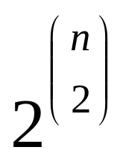
Graphs with n vertices
For a given set of n vertices,
we can make graphs.
n | 1 | 2 | 3 | 4 | 5
G | 1 | 2 | 8 | 64 | 1024

Slide 10
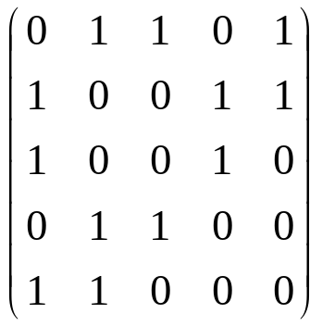
Matrix Representation
Let V = {v₁ … v_{n} } be ordered. The adjacency matrix of G is the n×n-matrix M with entries M_{ij} = 1 or M_{ij} = 0 according to whether v_{i}v_{j} ∈ E or not.
2
4
A graph has usually many different adjacency matrices.
1
3
5
G
Adjacency Matrix

Slide 11
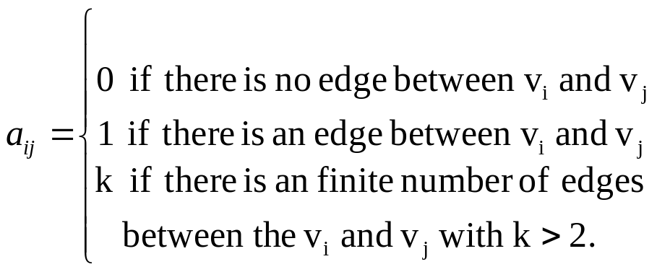
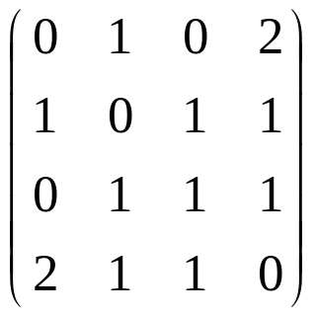
Adjacency matrix of multigraph
The adjacency of a multigraph G is defined as:
A
B
G
Adjacency matrix
C
D

Slide 12
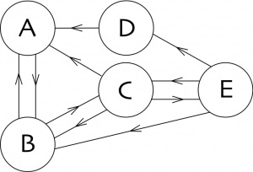

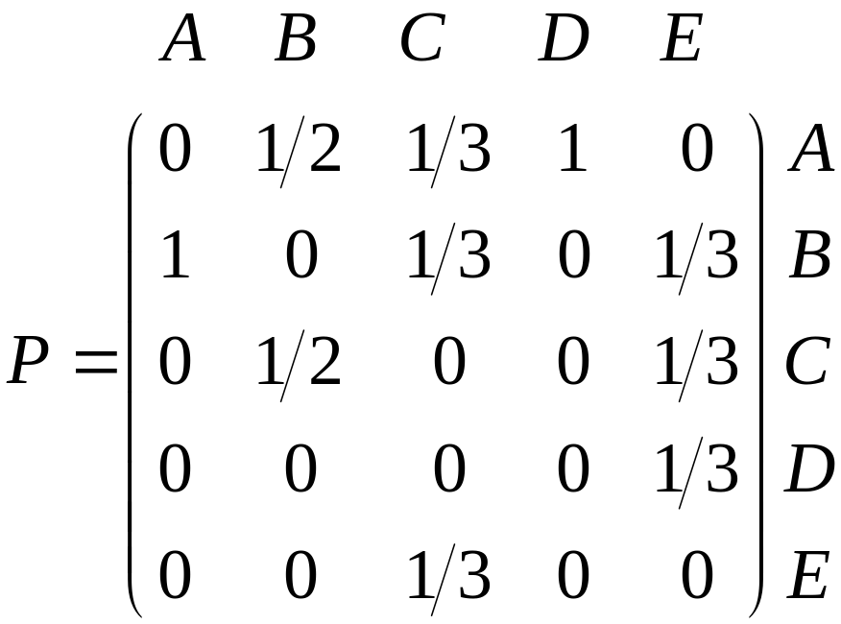
Random Walk
We summarize the web in the following matrix P.
How much is P²?

Slide 13
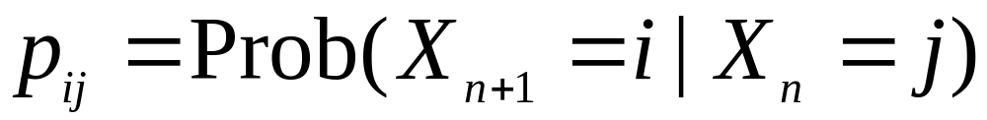
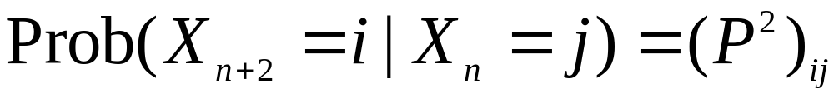
Random Walk
Note that this probability is independent of n.
We say that a Markov chain process has no memory of the past.
The probabilities after two steps can be summarized in the matrix P².

Slide 14

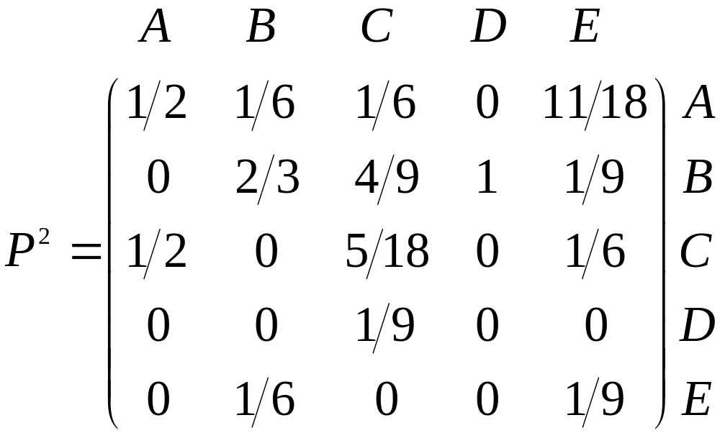
Random Walk

Slide 15
Random Walk
How much is P³?

Slide 16
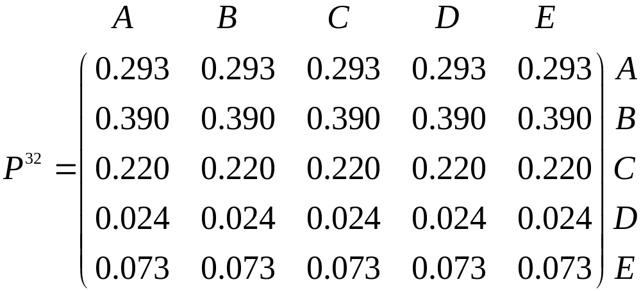
Random Walk
P³²?

Slide 17
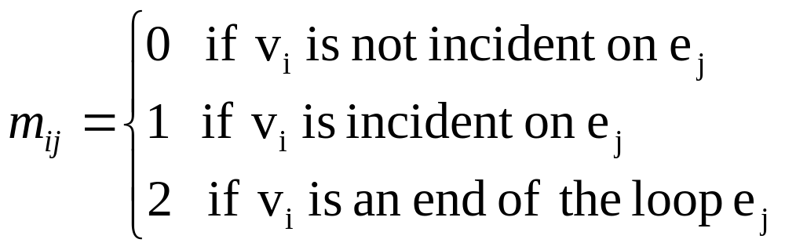
Incidence matrix
For a graph G with m vertices and n edges, the incidence matrix of G is defined as M(G) = (m_{ij})_{m×n}, where:

Slide 18
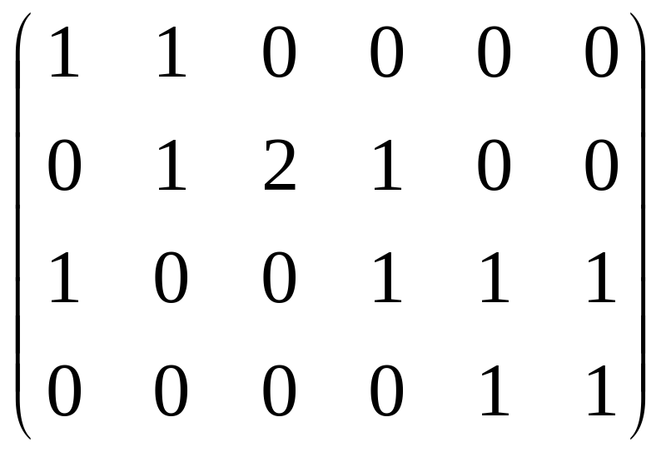
Incidence matrix
Incidence matrix of G:
v₁
e₂
e₃
v₂
e₄
e₁
e₅
v₄
v₃
e₆

Slide 19
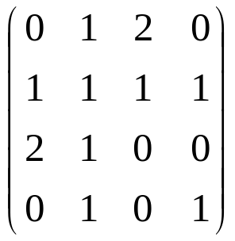
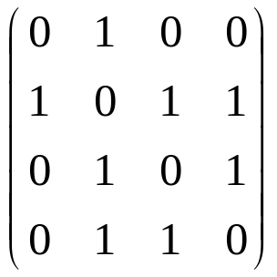
Exercise
Draw the graph whose adjacency matrix is:
Find the adjacency and incidence matrixes for
a.
b.
a
c
b
d
e
f
g

Slide 20
Isomorphism of Graphs
Definition. Two graphs G and H are isomorphic, denoted by G ≅ H, if there exists a bijection :
α: V_{G} → V_{H} such that
uv ∈ E_{G} ⇔ α(u) α(v) ∈ E_{H}
for all u, v ∈ G.
2
a
b
1
4
G and H are isomorphic.
e
c
3
5
d
G
H

Slide 21
Graphs with n vertices
For a given set of n vertices,
we can make graphs.
n | 1 | 2 | 3 | 4 | 5
G | 1 | 2 | 8 | 64 | 1024
Non-Isomorphic | 1 | 2 | 4 | 11 | 34

Slide 22
Theorem
Two graphs G and H are isomorphic if and only if they have a common adjacency matrix. Moreover, two isomorphic graphs have exactly the same adjacency matrices.

Slide 23
Isomorphic or not?
To prove G ≅ H, we give names to the vertices, provide a bijection between the vertex sets, and verify that the adjacency relation is preserved.
1
2
a
d
6
3
b
e
c
f
5
4

Slide 24
Isomorphic using matrix
The graphs G and H are isomorphic if and only if we can apply a permutation to the rows of A(G) and the same permutation to the columns of A(G) to obtain A(H).
w
y
c
d
x
z
a
b
G
H

Slide 25
Isomorphic or not?
If the graphs have many edges, we prefer to compare their complements.
Graphs G and H are isomorphic if and only if their complements are isomorphic.
G
H

Slide 26
Compliments
Compliment of G
Compliment of H
not connected
connected
They are not isomorphic.

Slide 27
The Petersen Graph
Petersen graph is a 3-regular graph of order 10.
Construct the Peterson graph

Slide 28
Automorphism
An isomorphism of G onto G is called an automorphism.
The automorphisms of G are the permutations that can be applied simultaneously to the rows and columns of A(G) without changing A(G).

Slide 29
Example of automophism
1
2
4
3
4
3
1
2
These two graphs are automorphic.
Interchanging vertex 1 and vertex 2 is not an automorphism of G.

Slide 30
Self-complementary
A simple graph isomorphic to its compliment is self-complementary.
b
1
5
a
c
2
4
3
e
d

Slide 31
Exercise
1. Show that the graphs G and H are isomorphic.
G
H

Slide 32
Exercise (contd.)
Is the graph given below isomorphic to the Peterson graph?

Slide 33
Exercise (contd.)
The riddle of Alcuin (735-804)
A shepherd was to cross a river by boat. He had with him a wolf, a lettuce and a goat. The boat can carry only the shepherd an one of the three. As is well known a wolf eats the goat and the goat eats the lettuce, if left unguarded on the same bank of the river.
How does the shepherd bring all three on the opposite bank using graphs?

Slide 34
Exercise (contd.)
Using graph, find the shortest solution of the maze given below.

Slide 35

NEXT
Graph (contd.)
Trees

Slide 36


